Slide 1
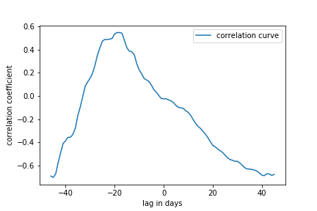
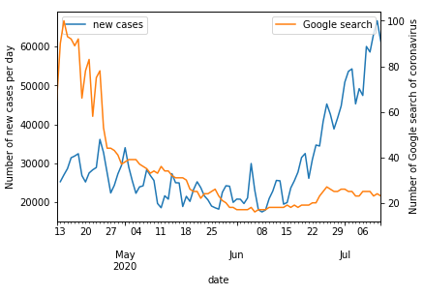
Capstone project
COVID-19 Policies
Stay in home order
Face masks
Reopening strategies
Data Sources
Johns Hopkins University
Google trends API
National Governor’s Association
Analysis
Time-lagged cross-correlation
Regression

